Slide 1

NC 20 Central Carolina Chapter Salisbury, Rowan County, NC
NCCOC 3rd Qtr Meeting West Jefferson 9 and 10 August 2013

Slide 2
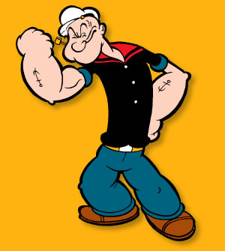
NC20 Central Carolina Chapter
We are what we are ….
Small chapter 67 members, one county served
6 Meetings per year
Enthusiastic, committed members
Focus on informative and interesting programs
Military
Military History
Veterans
Active, goal driven board

Slide 3
NC20 Central Carolina Chapter
Successes
Veterans support; homeless shelter and Christmas gift cards. Featured in MOAA magazine, pg 42
Thanks to Col Wayne Swiers, USAF
and Col Ty Cobb, USA
Visitors turn into new members; recruiting brochure, recognition
Dedicated board member, handles all admin, serves as chapter “memory”
Recent survey highlight pluses, minuses

Slide 4
NC20 Central Carolina Chapter
Survey designed to find out “How we are doing”

Slide 5
NC20 Central Carolina Chapter
Problems
Age of members
Lack of “tech savvy” members
E-newsletter, web site, etc. not valued
No one to start or keep technology running
Finding eligible prospective members; MOAA lists not effective
Succession difficult

Slide 6
NC20 Central Carolina Chapter
Summary
Great little chapter
Proud of outreach efforts
We will continue to grow

